Slide 1
Insurance management system
Parul Institute of Computer Applications
Semester 6 Project
2022-23
Team members
200510101159 & Aman Kumar Singh
200510101164 & Roshani Singh
Company Details
Phoenixzone Technologies Pvt Ltd

Slide 2
INDEX
Abstract
Comparison of New System with Existing System
Technology and HW, SW Requirement Specification
Modules and its short description
Users and their role description
Time Line Chart
Flow Chart Diagram
Data Flow Diagram (Level-0, 1,2)
Use Case, Class, Activity, ER Diagram
Data Dictionary
Limitations
Future Enhancement
References & Bibliography

Slide 3
Abstract
This website is an online micro insurance analysis and information management system that provides easy access of information regarding the people and resources of insurance. This site is not a static site but with wonderful dynamic facilities like search tools for insurance awareness article, guidelines, illustrations through images for visitors. This site also provides several dynamic features.

Slide 4
Comparison of new system with existing system
There will be a feature of raising ticket issues and tracking the tickets module which will help the customer to solve their queries.
There will be seperate control panel for both Customers and Admin.
This project is developed in PHP Language, so it is easier to use and manage.
Previous systems doesn’t have modules like Insurer and Policy, which provide easier accessibility to both users and admins.

Slide 5
Technology and HW, SW Requirement Specification
Programming language is used to proposed this System is PHP Language and MySQL server.
Code will be implemented in Microsoft Visual Studio Code.
Hardware Requirements:
Pentium IV Processor
Storage – 50 GB or more
Ram – 2 GB or more
Software Requirements:
Windows 7 or any Linux Distro or MACOS
PHP Triad (PHP5.6, MySQL, Apache, PHPMyAdmin)
Any IDE (Code Editor like VS Code) and updated Browser

Slide 6
Modules and its short description
This system is consist of two module -
1) User Module
2) Admin Module
User Module
This module having two sections -
1) Insurance
2) Ticket

Slide 7
Modules and its short description
Admin Module
This module having seven sections -
1) Login
2) Registration
3) Insurance Category
4) Insurance Sub-category
5) Insurance Policy
6) User Details
7) Policy Holders
8) Tickets
9) Insurance
Both users can view, update their profile and change there password.

Slide 8
Features and its short description
Some features of this system are -
PHP Triad: It is widely used general purpose language that is especially suited for web development and can be embedded into HTML. It primarily acts as a filter, taking input from a file or stream containing text and it automatically detect the language of the user.
Speed Optimization: PHP scripts are normally kept as human-readable source code, even on production web-servers. In this case scripts will be compiled at run time by the PHP engine, which increases their execution time.

Slide 9
Features and its short description
Some features of this system are -
Security: There are advanced protection patches such as Suhosin and Hardening-Patch, especially designed for web hosting environments. With respect to security the code itself, PHP code can be obfuscated to make it difficult to read while remaining funtional.

Slide 10
Users and their role description
There are two users in this system – Admin and Normal User
Admin can manage of the system main modules like managing insurances & the policies and solving the tickets of the users.
User can take the benefits by using insurance features and raised tickets if they found any trouble.

Slide 11
Time Line Chart
Development phase | 75 Days |  |  |  |  |  | Duration N (days)
 | 0to10 days | 11to20 days | 21to30 days | 31to40 days | 41to50 days | 51to75 days
Requirement Gathering |  |  |  |  |  |  | 07
Analysis |  |  |  |  |  |  | 09
Design |  |  |  |  |  |  | 10
Development Phase 1 |  |  |  |  |  |  | 13
Development Phase 2 |  |  |  |  |  |  | 13
Development Phase 3 |  |  |  |  |  |  | 13
Documentation |  |  |  |  |  |  | 10
Total time (Days) |  |  |  |  |  |  | 75

Slide 12
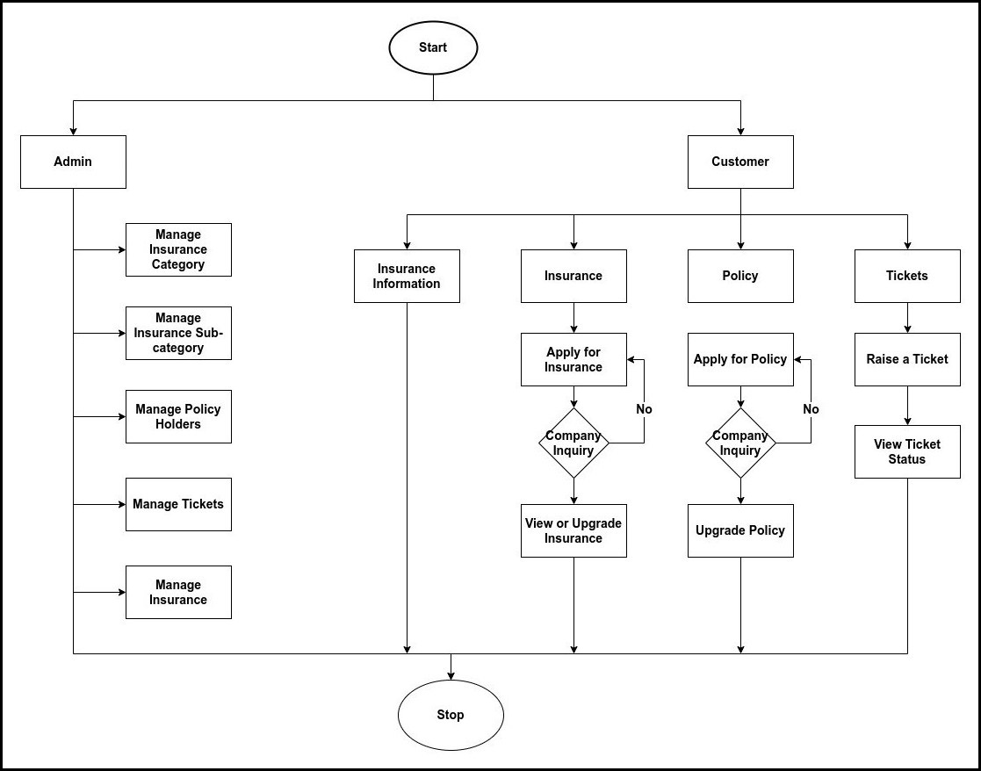
Flow chart diagram

Slide 13
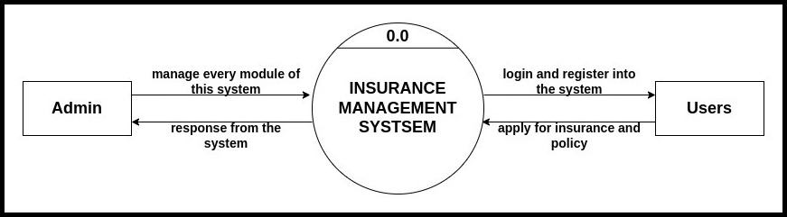
Data flow diagram (Level-0)

Slide 14
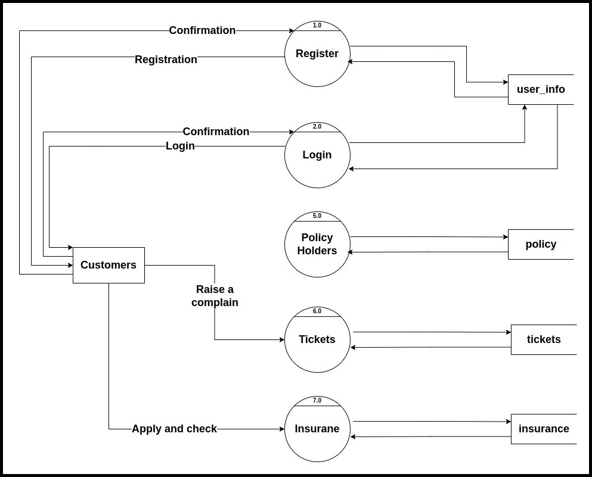
Data flow diagram (Level-1)

Slide 15
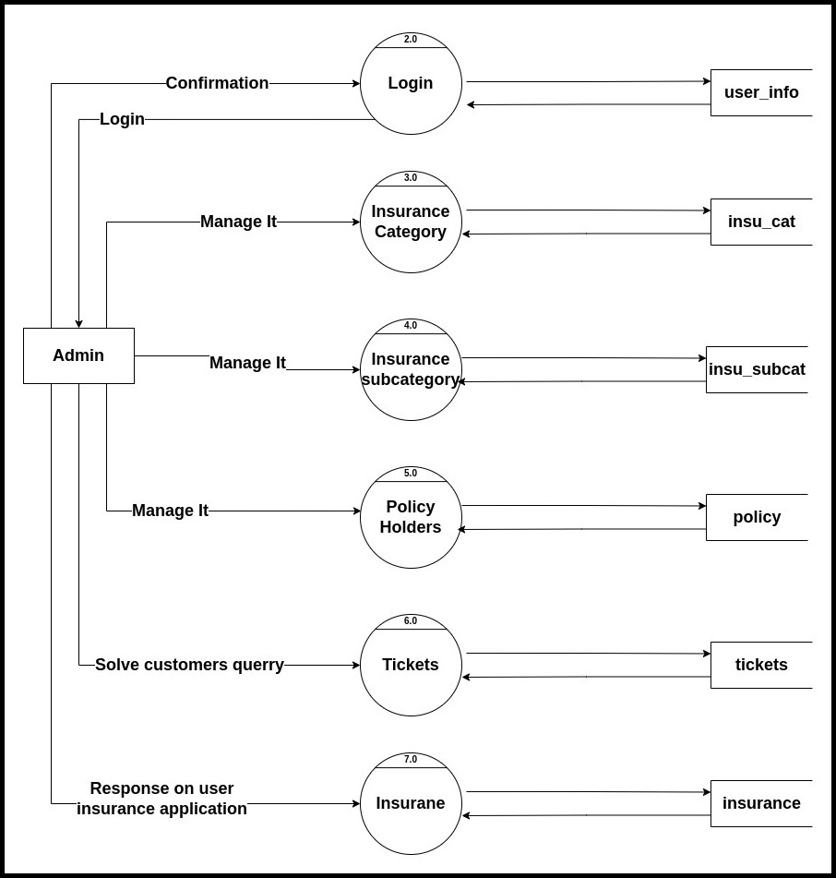
Data flow diagram (Level-1)

Slide 16
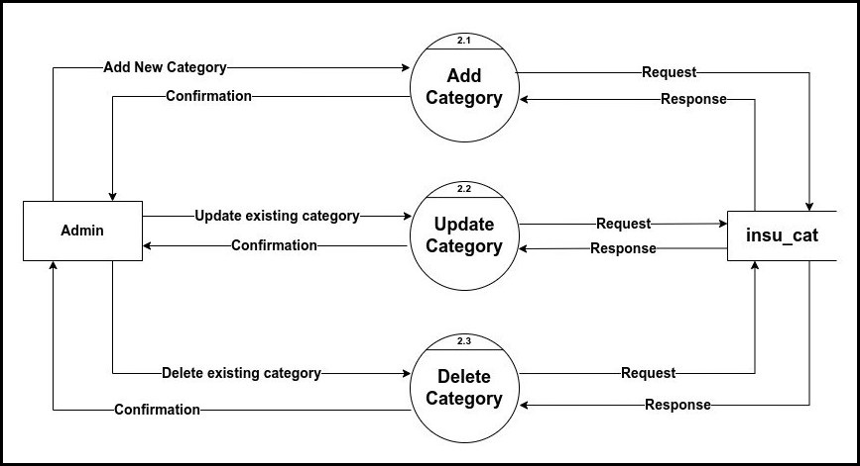
Data flow diagram (Level-2)

Slide 17
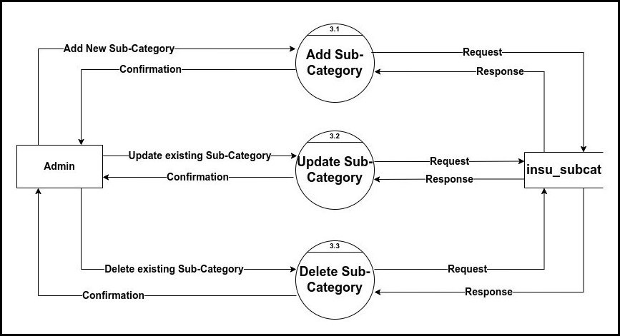
Data flow diagram (Level-2)

Slide 18
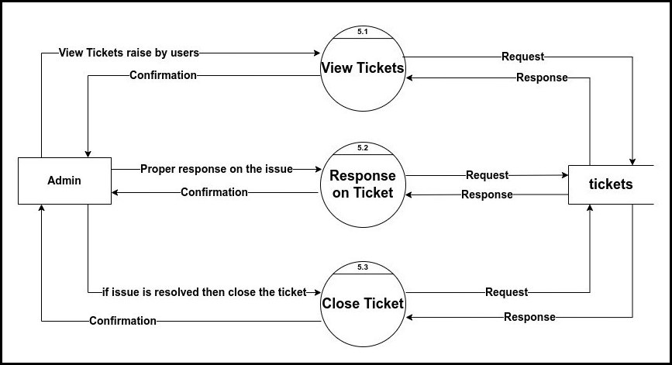
Data flow diagram (Level-2)

Slide 19
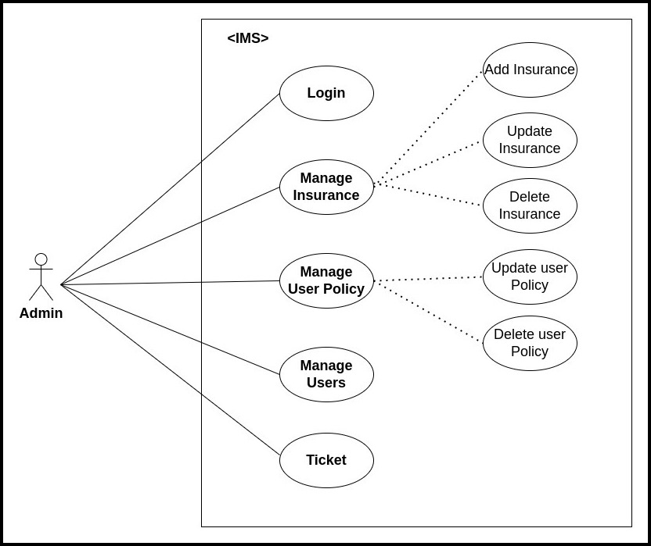
Use case Diagram

Slide 20
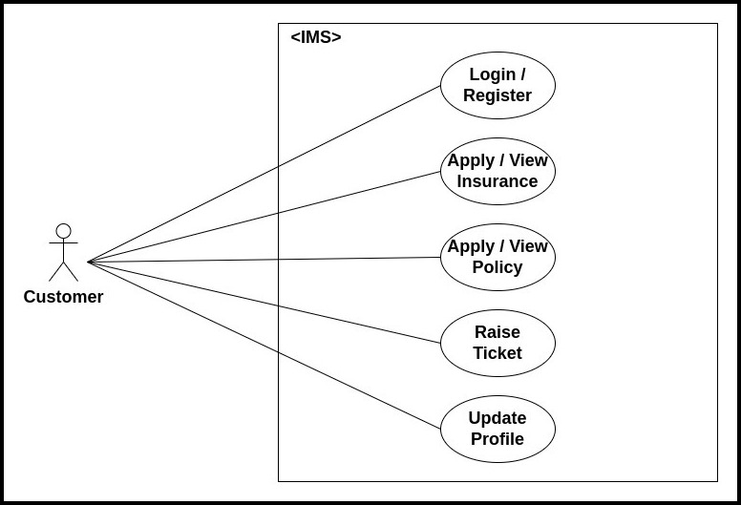
Use case diagram

Slide 21
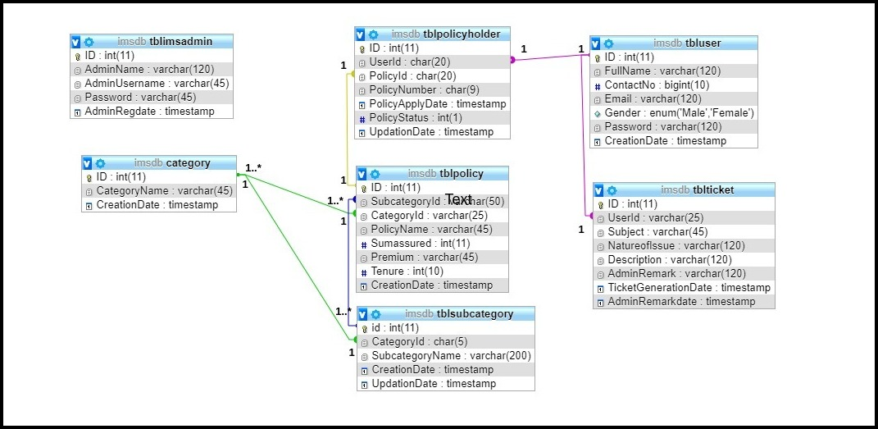
Class diagram

Slide 22
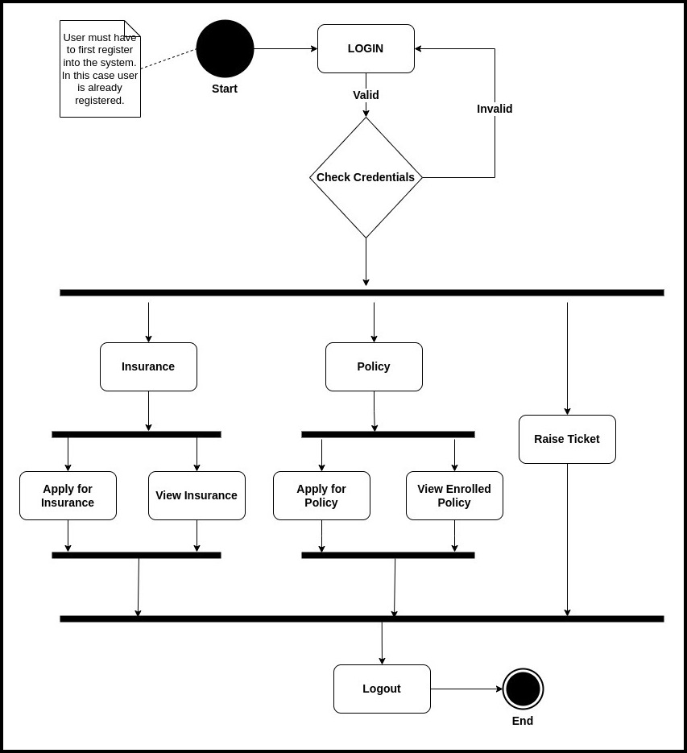
Activity Diagram

Slide 23
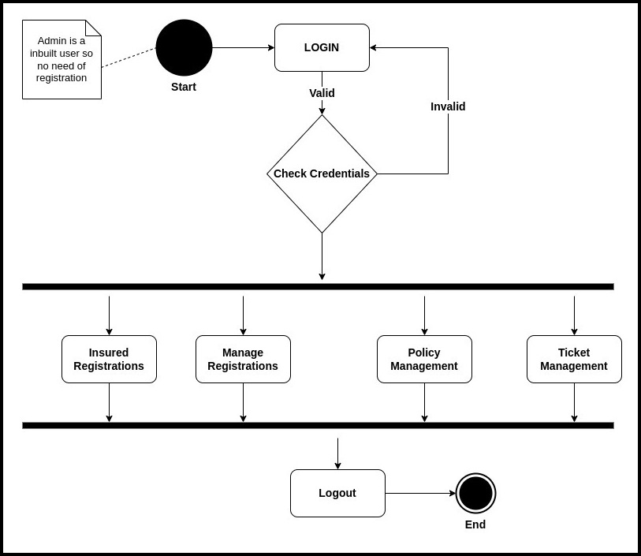
Activity Diagram

Slide 24
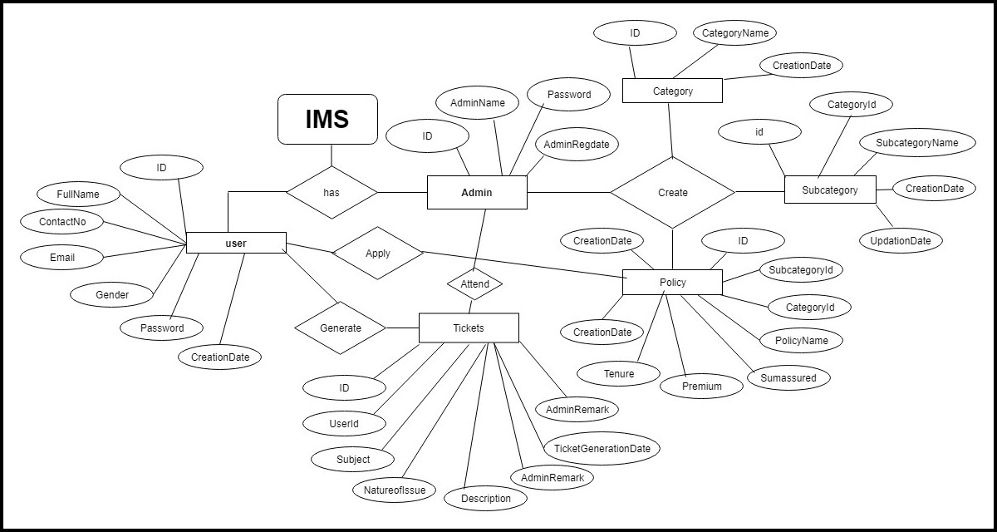
ER Diagram

Slide 25
Data dictionary
Sr. No | Field Name | Datatype | Size | Description | Constraint | Example
1 | Username | varchar | 20 | Unique id of username | Primary Key | amankrs21
2 | Password | varchar | 20 | Password for unique id |  | *******

Slide 26
Data dictionary
Sr. No | Field Name | Datatype | Size | Description | Constraint | Example
1. | Username | varchar | 20 | Username of customer | Primary Key | 23252
2. | Full Name | varchar | 20 | Name of the User |  | Aman Singh
3. | Contact No | varchar | 10 | Contact Number of the User |  | 7079818064
4. | Address | varchar | 50 | Full Address of the user |  | Waghodia
5. | City | varchar | 10 | Current city of the user |  | Vaodara
6. | State | varchar | 10 | Current state of the user |  | Gujarat
7. | Country | varchar | 10 | Current country of the user |  | India

Slide 27
Data dictionary
Sr. No | Field Name | Datatype | Size | Description | Constraint | Example
1. | Admin Name | varchar | 10 | Name of the Admin |  | Admin
2. | Admin Username | varchar | 10 | Username of Admin | Primary Key | admin
3. | password | varchar | 20 | Password of the user |  | ******
4. | regdate | datetime |  | Date and time of admin register |  | 12-12-2022

Slide 28
Data dictionary
Sr. No | Field Name | Datatype | Size | Description | Constraint | Example
1. | userid | varchar | 20 | ID of user | Foreign Key | amankrs21
2. | policyid | varchar | 20 | ID of Policy | Primary Key | RD7529BYT
3. | policynumber | varhcar | 20 | Policy Number |  | 8784782647
4. | applydate | datetime |  | Apply Date Time of insurane |  | 12-12-2022
5. | policystatus | int | 1 | Status of the Policy |  | True
7. | updatedate | datetime |  | Update date time of policy |  | 12-12-2022

Slide 29
Data dictionary
Sr. No | Field Name | Datatype | Size | Description | Constraint | Example
1. | id | int | 10 | ID of the category | Primary key | 1
2. | categoryname | varchar | 20 | Name of the category |  | Health Insurance
3. | Categorydate | datetime |  | Date of category |  | 12-12-2022

Slide 30
Data dictionary
Sr. No | Field Name | Datatype | Size | Description | Constraint | Example
1. | id | int | 10 | ID of Sub-Category | Primary Key | 1
2. | categoryid | varchar | 5 | Id of the category | Foreign Key
3. | subcatname | varchar | 20 | Name of Subcategories
3. | createdate | datetime |  | Date of Creation |  | 12-12-2022
4. | updatedate | datetime |  | Date of Updation |  | 12-12-2022

Slide 31
Limitations
This System still having some bugs which needs to be resolved. This bugs also cause some security issues which make this system vulnerable.
UI of this system should be more improved, which we will do in the future enhancement.
The System is not capable of supporting multiple users at a time, it requires a good server hosting.
Thus this system is online, so users should have a good internet connection to use this system.

Slide 32
Future Enhancement
We will always try to fix bug time to time.
We will also try make this system as much easy as can for users.
And we will also try to improve UI of the System.
We will try to add some automation in this system that can reduce the burden of the Admin

Slide 33

Project video

Slide 34
References & Bibliography
Website:
https://in.php.net/
https://dev.mysql.com/doc/
https://github.com/
https://stackoverflow.com/
https://www.quora.com/
https://w3schools.com/
https://www.geeksforgeeks.org/
https://www.khanacademy.org/
Book:
PHP in Advanced
SQL Beginners Guide
Other Resources:
Some Journals
YouTube

Slide 35
Thank you !!!

